Slide 1
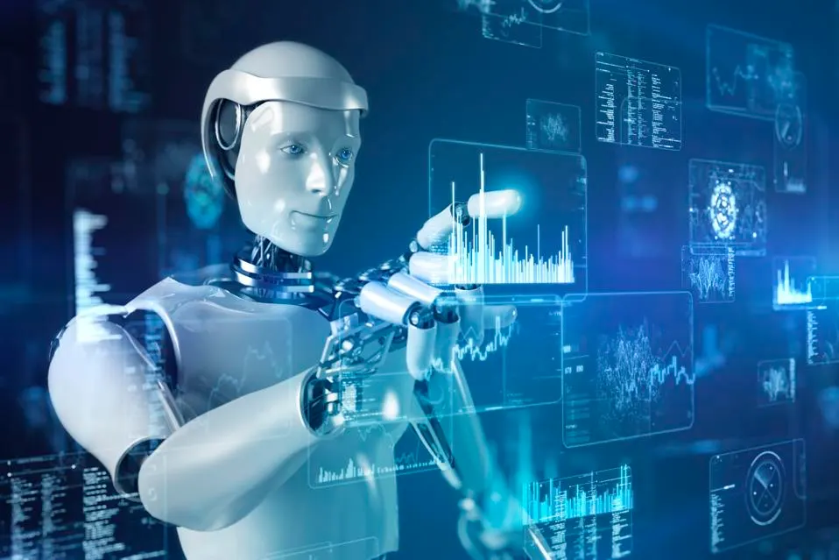


Slide 2

Who Am I?
Name: Ben Meir
Age: 33
Education: BS in Industrial Engineering and Management from Ben-Gurion University Current Workplace: Natural Intelligence Selected as the 15th top high-tech company to work in 2021 Current Position: Backend Software Developer (Focus on Machine Learning & AI Development) Experience: more than 5 years in the industry (Solaredge, Bizzabo, Natural Intelligence)

Slide 3


Slide 4

High-tech industry introduction
High-tech industry - A company considered a high-tech company when its core business involved working on the most advanced technologies available ( “cutting edge” technologies)
When the company core business involved working on traditional or mechanical technology we can call it low-tech company
When high-tech become old it will be consider from this point as low-tech For example: Company that its main business is selling home phones - Once we could consider it as high-tech company but now its an old technology so we consider it as low-tech company

Slide 5

The Israeli High-tech industry
Israel nickname is “the startup nation” and located as the second most advanced high tech industry country in the world (the first is USA)
Today working in israel more than 2500 high tech companies and startups from variety of industries
In 2021 alone more than 15 high-tech companies went public and started trading at USA stock market
In 2021 alone Israel created more than 17 new “unicorns” Unicorn - is a nickname of a startup that value more than 1 Billion dollars (1,000,000,000$)

Slide 6










Slide 7
Why the high tech industry is important to Israel?
Only 10% of the entire isreali workers are working in high-tech companies, But because of the high salaries those workers are responsible for almost 25% of the tax income
In addition, high tech companies are providing a lot of work to other undirected small business For example:
By providing 10bis for the employees they provide customers to multiple restaurants
By renovating the company offices every couple of years the support renovators

Slide 8
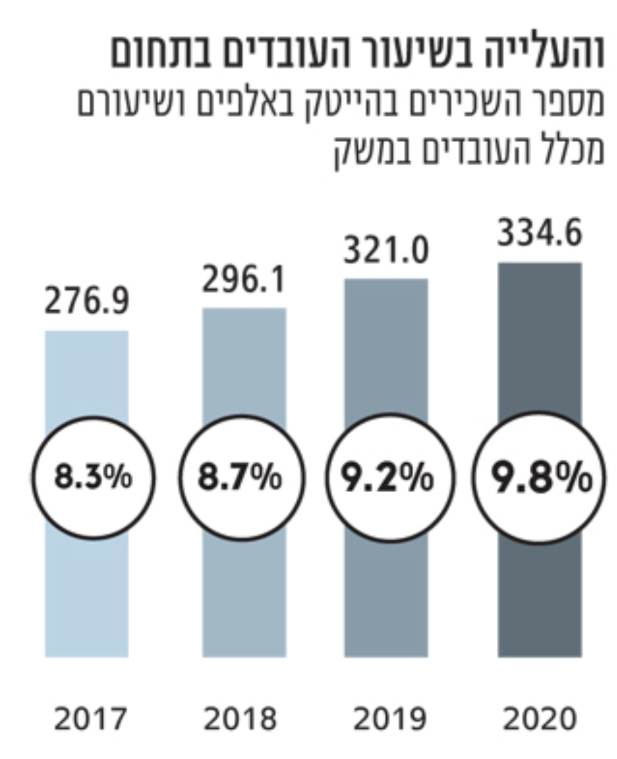
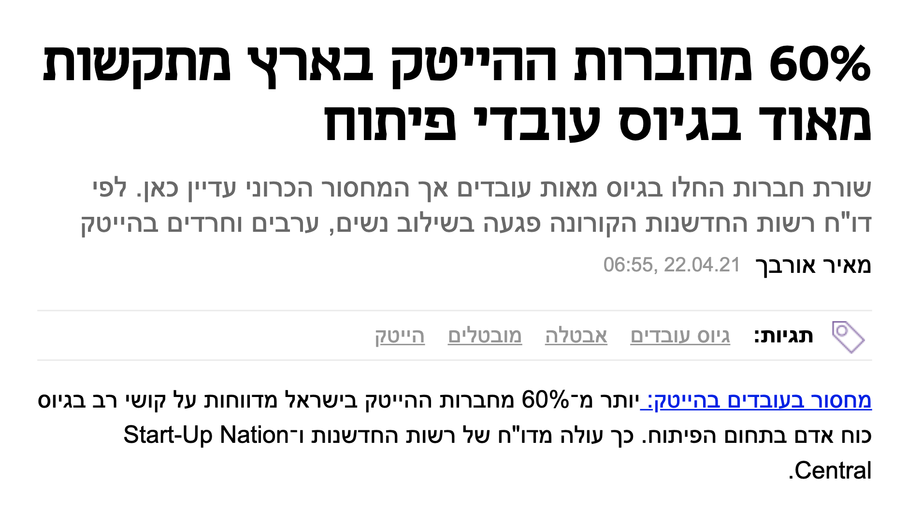

Slide 9
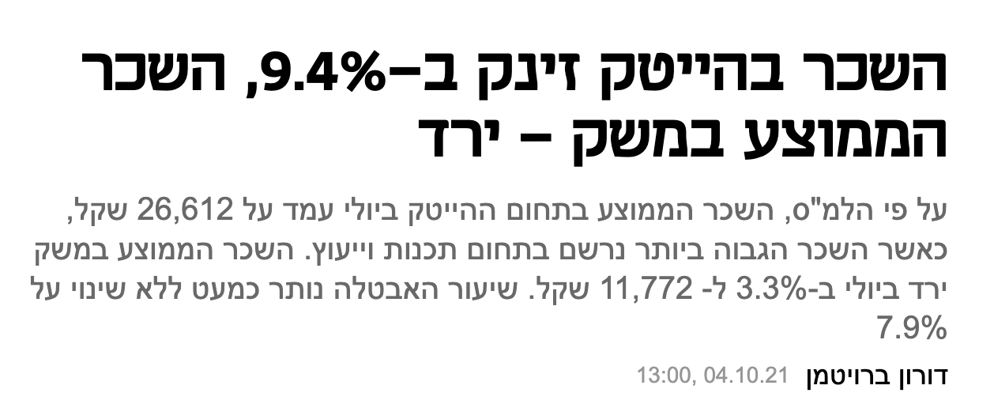
Why people want to work in the high tech?
High Salary:
By July 2021 the average salary in Israel stand on 11,772 NIS
The average salary in the high tech for that period stand on 26,612 NIS
As you can see the high tech employees are making more than twice as much money

Slide 10
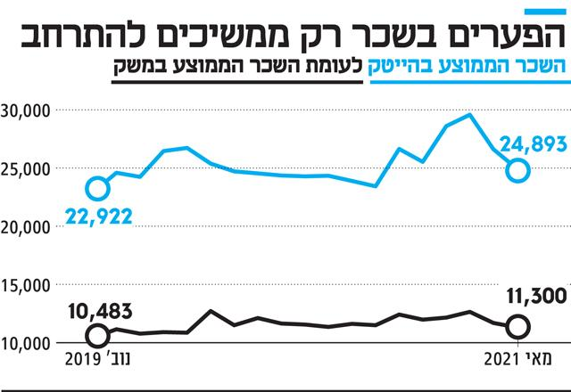

Slide 11
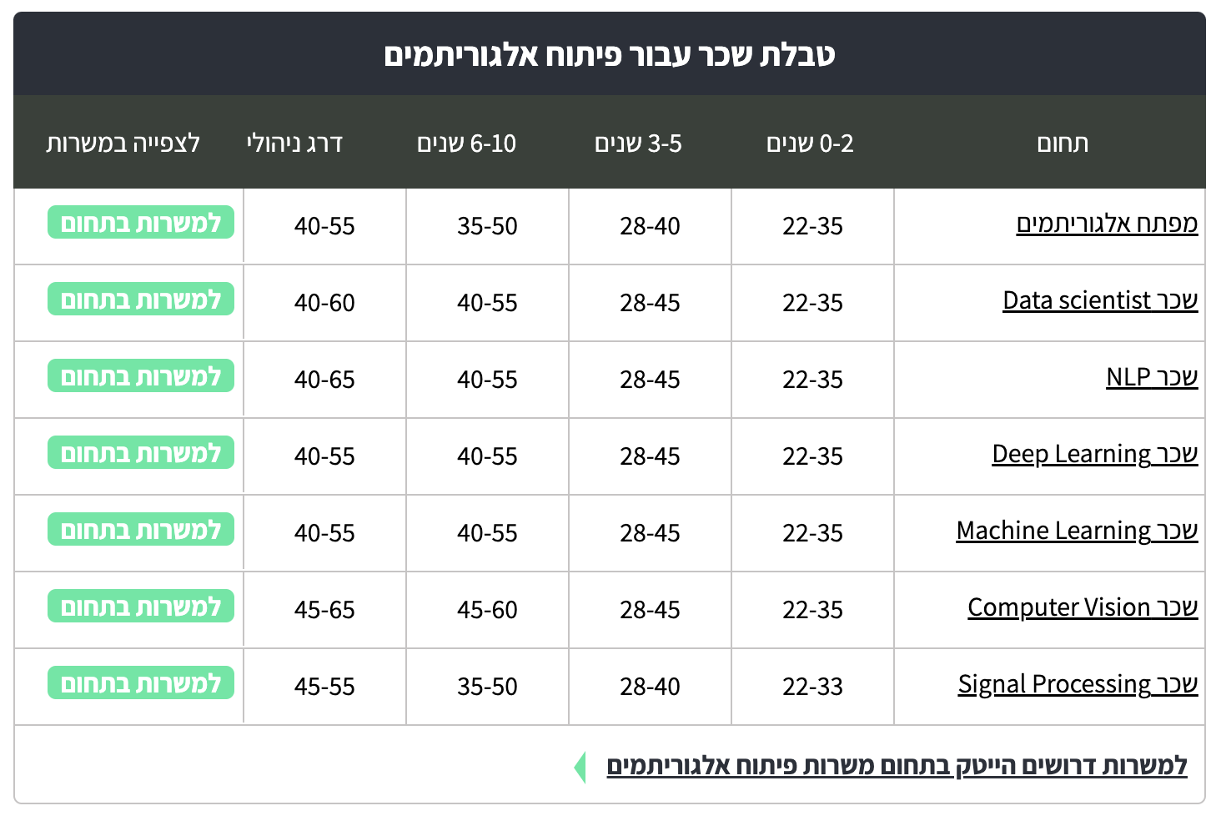
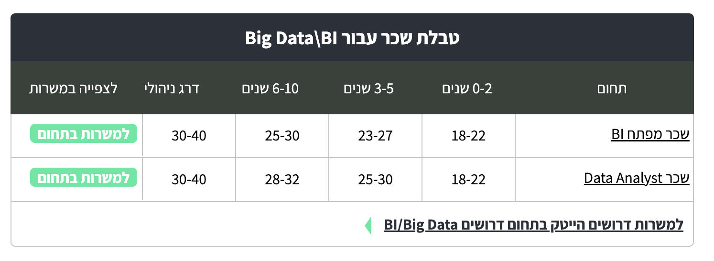

Slide 12
Why people want to work in the high tech?
Challenge and Promotions:
High tech companies are known for their ability and willingness to promote excellent employees. Promotions can be at the managerial level or at the professional level and in most cases will involve with upgrading your contract conditions (higher salary, more vacation days exc…)
For example:
Manual QA can change his role to automation QA developer
Data analyst can change his role to Data scientist or Data engineer
AI developer can be promoted to Team Lead (managerial level) or to Senior Developer (professional level)

Slide 13
Why people want to work in the high tech?
Amazing work conditions: In almost every high tech company you will get:
Between 17 - 24 vacation days
Sick days payment starting from the first day
Pension and “Keren Hishtalmot” on your entire salary amount
No clock hours required (You will be magared according to your work and not how much time you spent in the office )
Hybrid environment - working from the office and from your home

Slide 14
Why people want to work in the high tech?
Other “Pinukim”:
10bis / Cibus
Food and drinks will be available anytime you want in the company kitchen
Amazing gifts for holidays and birthdays
Company events and parties happening, on average, every couple of months
Company trip, on average, once a year (sometimes it will include a flight :)

Slide 15
How to become an AI Developer?
The traditional path - Successfully graduate with a Computer Science / Industrial Management or software engineering degree from a known institution. Average Time to enter: 3-5 years
The non traditional path -
Taking an AI software development boot camp course Average Time to enter: 1-1.6 years
Start working at a different role in the company and once you approve yourself request to change your position to an AI software developer Average Time to enter: 2-3 years
Learn everything that related to AI software development by yourself Average Time to enter: 2-3 years

Slide 16

Skills you must have to become an AI Developer
Excellent control in the english language
Feel comfortable with numbers and statistics
Be an autodidact person - ability to learn things on your own
Be a problem solver - keep thinking on solutions to problems and not just raise those problems
Be curious, ask questions and always drive yourself to learn more
Be a team player

Slide 17
Types of software development
Because we can use software to automate many things in many areas we will see that there are many different types of software development. Often, the various kinds of developers work together to bring a project to producaction.
AI Developer / AI Engineer → AI Developer is responsible to use existing AI tools and AI algorithms and combine them in the company products and tools. AI developer needs to understand both in the Data Science field (machine learning algorithms, AI algorithms and data analysis) and also in the Computer Science field (Web development, API, Data Structure).
Frontend developer - work on the part of the product with which the user interacts. They are primarily concerned with the user interface (UI). For example, they might create the layout, visual aspects, and interactive elements of a website or app.

Slide 18
Types of software development
Backend Developer - works with the part of the product users can’t see — the back end. This professional builds the infrastructure that powers the website, app, or program, focusing on functionality, integration of systems, and core logic. They will also deal with the complex, underlying structure, ensuring strong performance, scalability, and security.
Full Stack developer - works on all aspects of the product, including both the front and back ends, Also called End-to-End. To be a successful full-stack developer, you must have strong programming skills, as well as a deep understanding in both the Frontend development fundamentals and the Backend. You must be familiar and comfortable working with both technologies.

Slide 19
Types of software development
Mobile Developer - builds applications that run natively on mobile devices, including smartphones, tablets, and some types of smartwatches. Usually, these professionals will specialize in either iOS or Android development but not both.
Game Developer - help transform games from a concept to a playable reality. They do this by coding visual elements, programming features, and testing iterations until a game is ready for market. The type of work you do as a game developer will vary depending on the size of the company you work for and your specialization. At bigger game companies, you’re more likely to have a more specialized role working on a specific element of the game. At small companies you may have a hand in multiple processes in a game’s lifecycle.

Slide 20
Types of software development
Devops Developer - DevOps is a set of practices and philosophies that are focused on the quick, efficient, and customer-centric delivery of software. A DevOps developer introduces processes, tools, and methodologies to balance needs throughout the software development life cycle, from coding and deployment, to maintenance and updates.
Test Automation Developer - design and write programs that run automated tests on new or existing software – an essential part of the software development cycle. They use automation frameworks (standardised guidelines) to build these programs on and write test scripts that do the testing.

Slide 21
What We Are Going To Learn In This Course?
Python3 - Backend programming language
Python Libraries for Data Science - Numpy, Pandas, Matplotlib, Seaborn
Python OOP - Object oriented programming with python
Version control software - Git & Github
API & Web - HTML, Web Scraping, Request - Response Model
Relational Databases - SQL & Mysql
Data Structure Algorithms - Different data structures & Big O Notation
Supervised Learning - Linear Regression, Decision Trees, Support Vector Machines
Unsupervised Learning - Clustering, Dimensionality Reduction, and Anomaly Detection
Deep Learning - Neural networks (CNN, RNN), frameworks (TensorFlow, Keras)
Reinforcement Learning - Algorithms Like Q-Learning, Markov Decision Processes
Natural Language Processing (NLP) - Text preprocessing, Named Entity Recognition (NER)

Slide 22

Q&A

